Slide 1

Word Data Extractor
Mason Lanham
Austin Meredith
Luis Carrillo
Chris Mendoza
David Garcia
Notes:
Team slide copied since beginning Let’s introduce ourselves, starting with David since he’s introducing the project

Slide 2
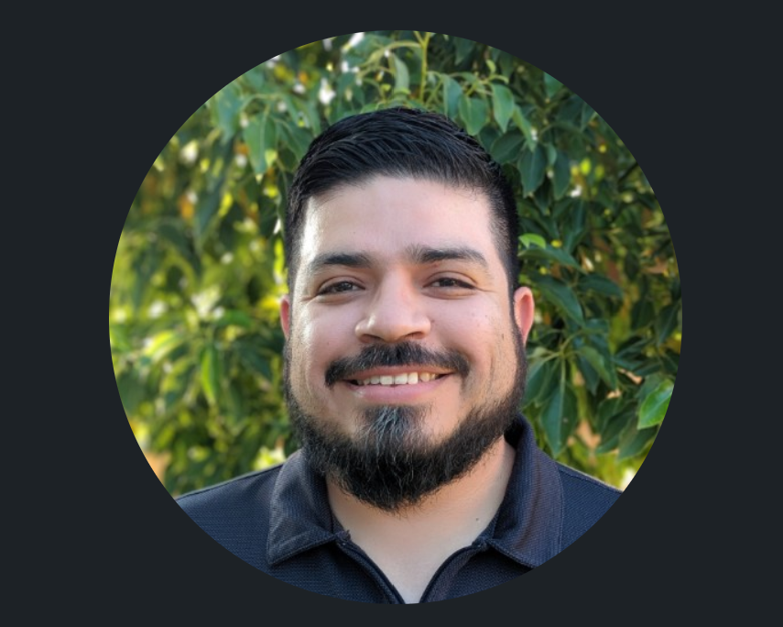
Purpose, Problem, & Need
David Garcia
Purpose: To extract data from procedure documents.
Problem: Procedure documents without carrying binders of pages.
Need: To have procedure documents on hand with minimal hardware
Notes:
Purpose of the program

Slide 3
Team Charter
David Garcia
Goals:
Well documented program
Efficiently running program
Better grasp of the Software Development Lifecycle

Slide 4
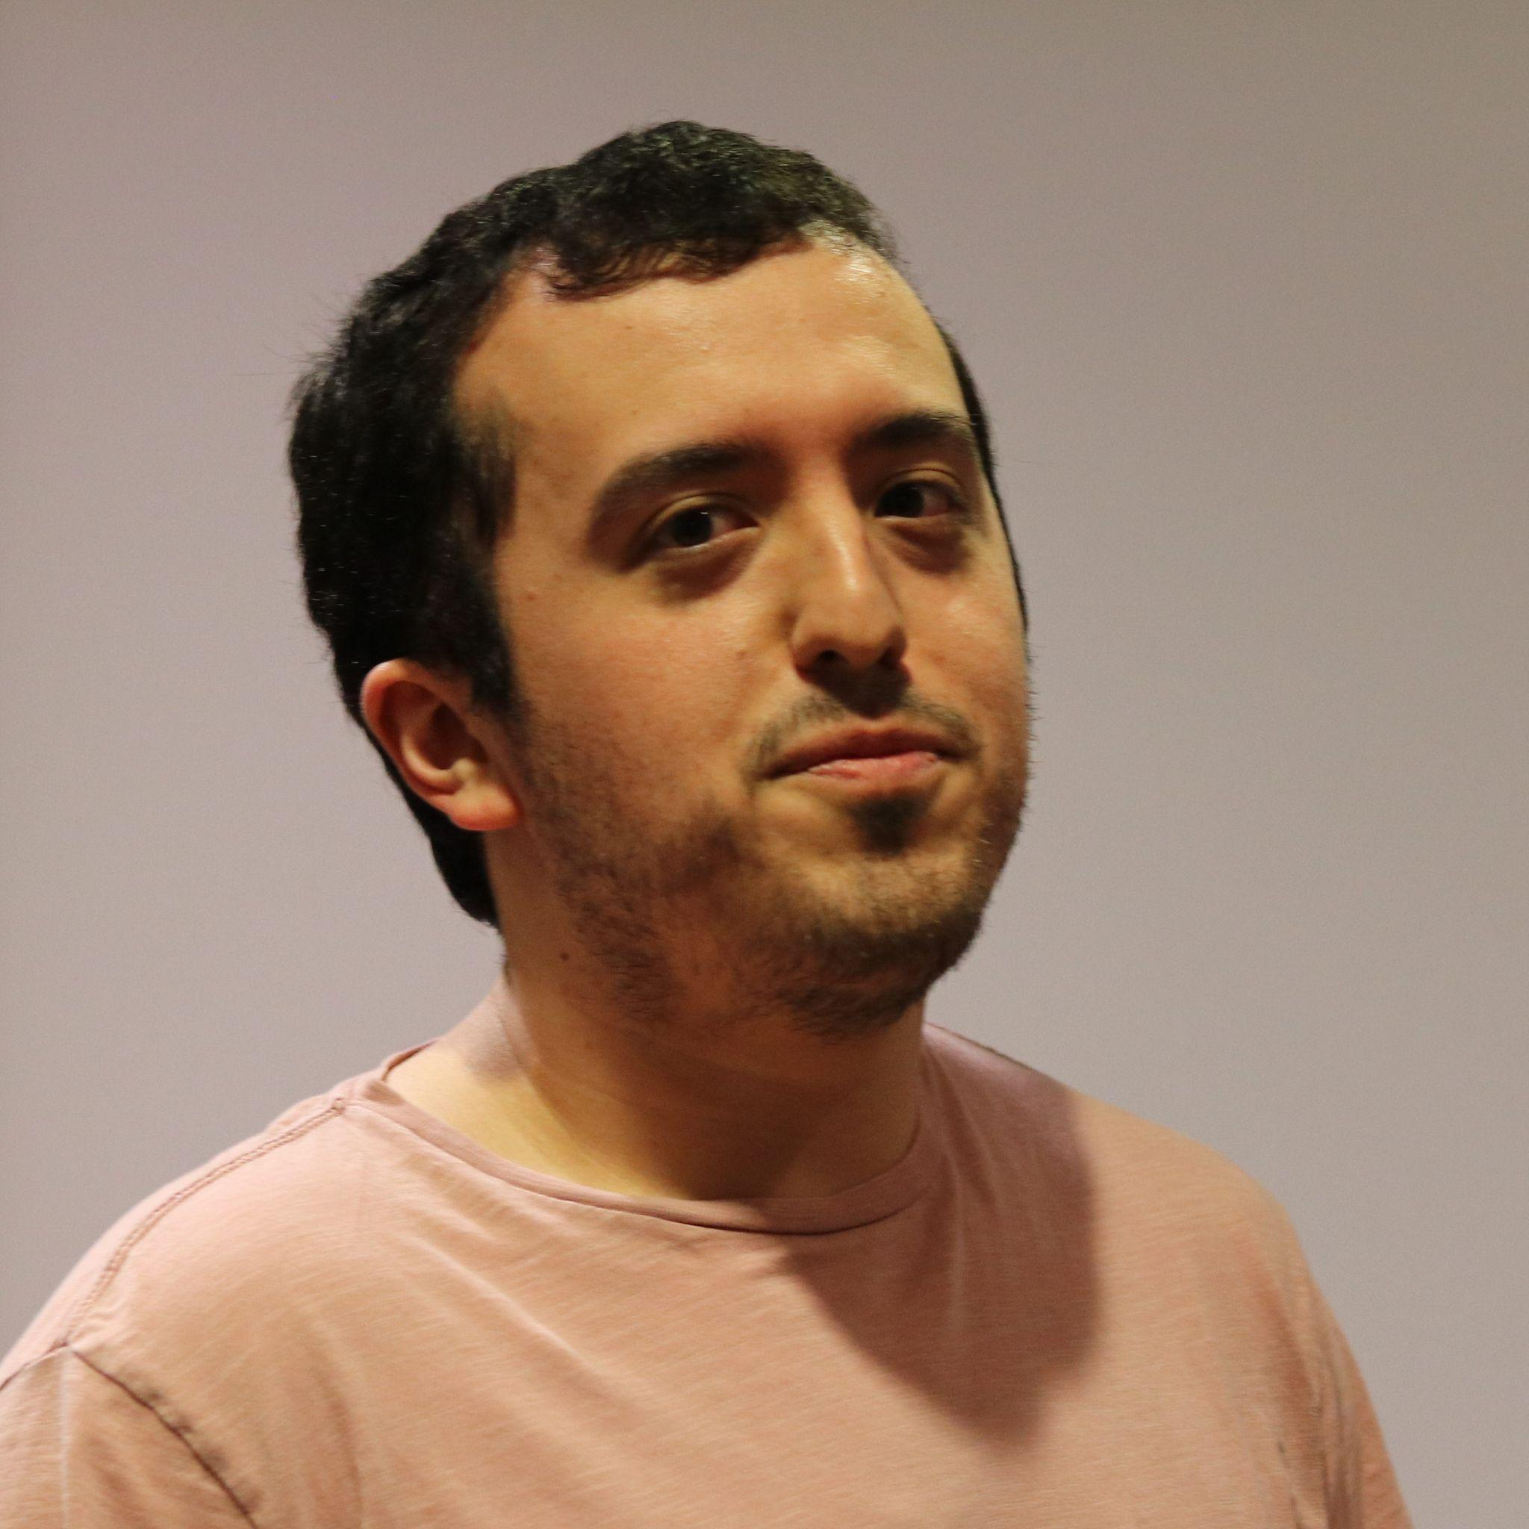
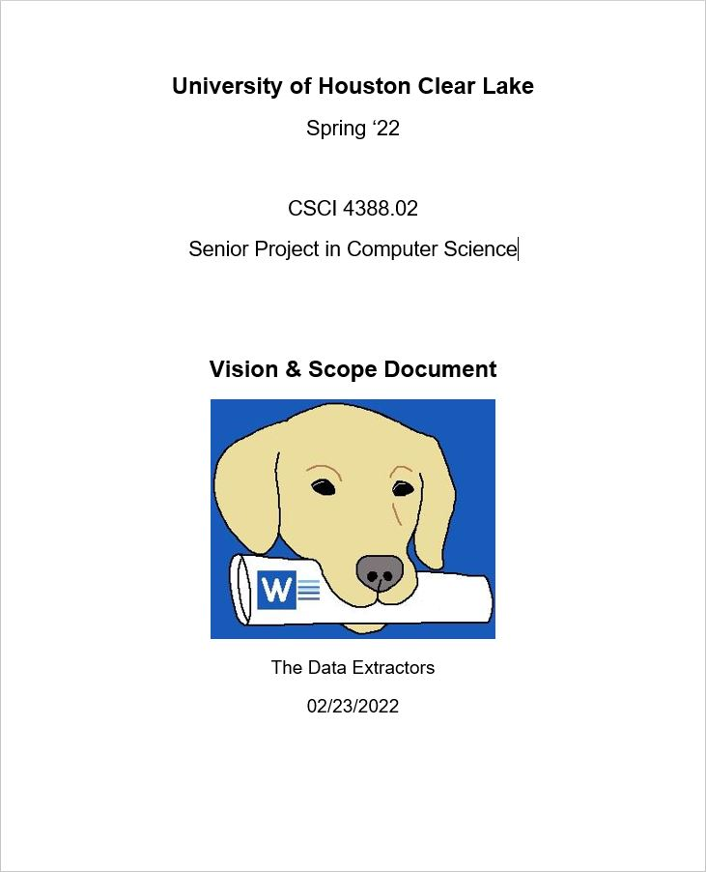
Vision + Scope Document
Luis Carrillo
Written early on to give the development team a chance to:
Understand the purpose of the software
Clarify what the software should do
Determine features that will be implemented

Slide 5
Project Features
Luis Carrillo
Command Line Input
Accepts .docx format files as input
Parser to go through documents and retrieve data
Generates XML file as output
Features NOT Included
Mobile or Web-based version
No support for .doc format files (outdated)
No GUI

Slide 6
Project Plan

Slide 7

Project Plan
Lee Austin Meredith
We created a Statement of Work which described our roles and responsibilities, as well as our rough estimates of how long things would take.
Resource List which included our personal devices, devices available on campus, Visual Studio Code & .docx documents provided by Tang for processing
Risk Plan in case of unexpected events, from a teammate dropping out to simple scheduling conflicts

Slide 8
Software Requirements Specification
Lee Austin Meredith
Written to give the developers a clear and concise overview of their responsibilities while working on the project
7 Use Cases covering everything from starting the program, command uses, to termination
4 Functional Requirements including the parsing of the documents and it outputting valid XML following our design
8 Non-Functional Requirements from swift performance, steady reliability, to ensuring document compatibility
Notes:
Killed it ;)

Slide 9
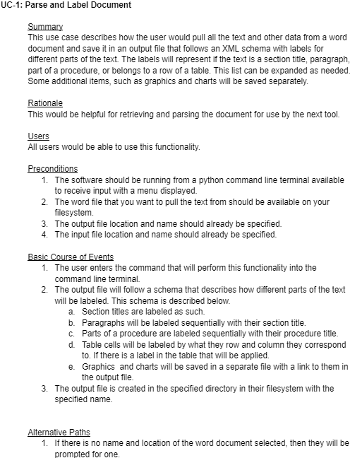
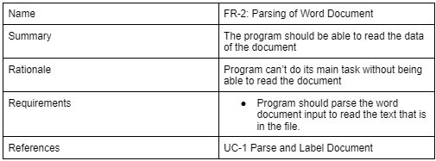
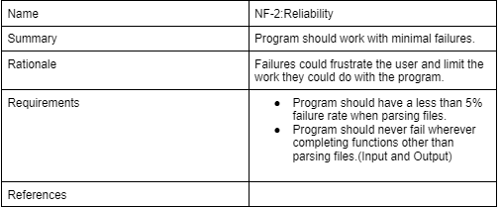
Software Requirements Specification
Lee Austin Meredith
Notes:
Killed it ;)

Slide 10
Work Breakdown Structure
Lee Austin Meredith
-Initiation: Introductions, role assignments, drafted a Team Charter.
-Documentation: Gathering requirements, creation of the SRS & WBS, Vision & Scope.
-Design: Following the documentation to design what we were to be coding.
-Coding: Using the design documentation, we created each feature and command separately.
-Testing: Test planning, execution, and debugging.
-Deployment: Follow-up, review, and presentation.

Slide 11
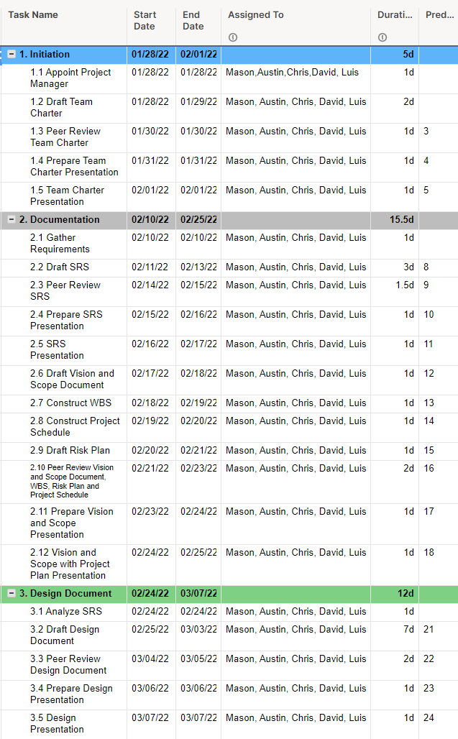
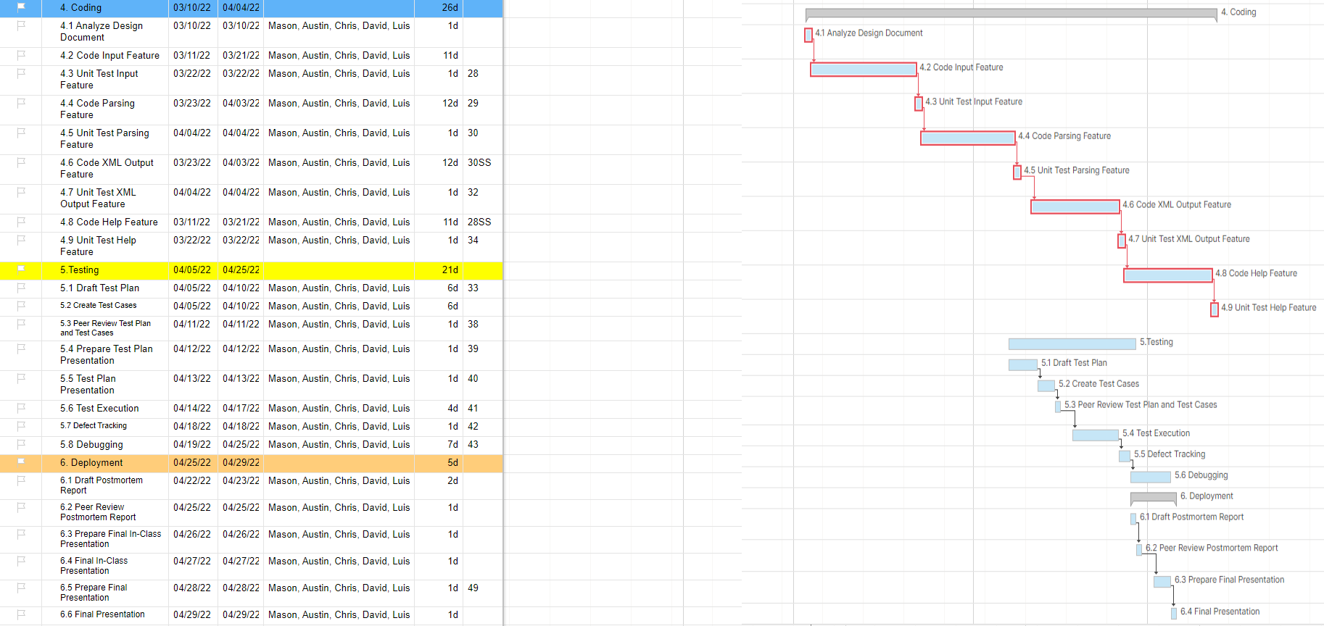
Project Schedule
Lee Austin Meredith

Slide 12
Design Documentation

Slide 13
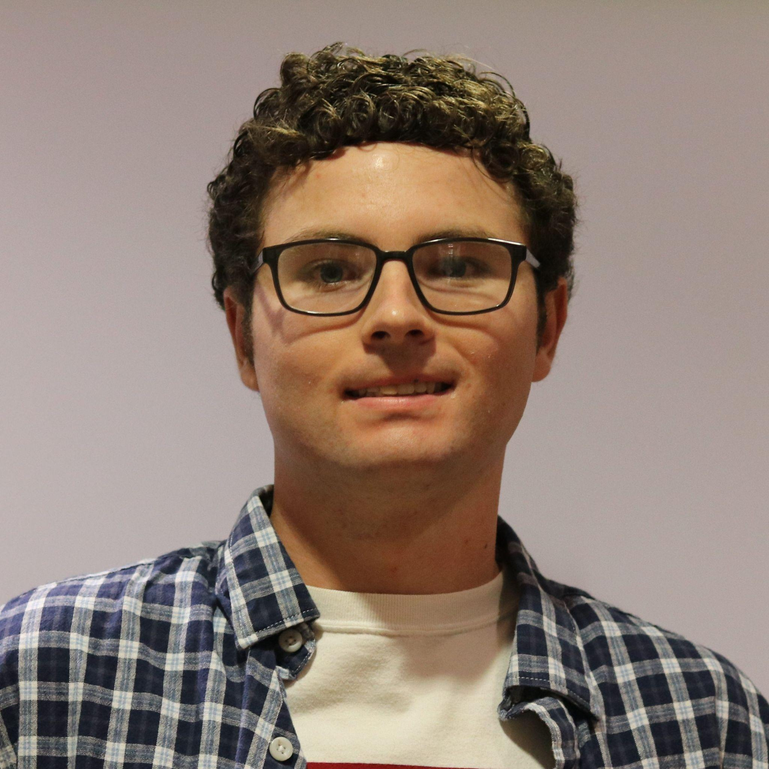
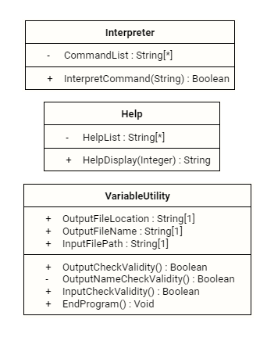
Command Line Classes
Mason Lanham

Slide 14
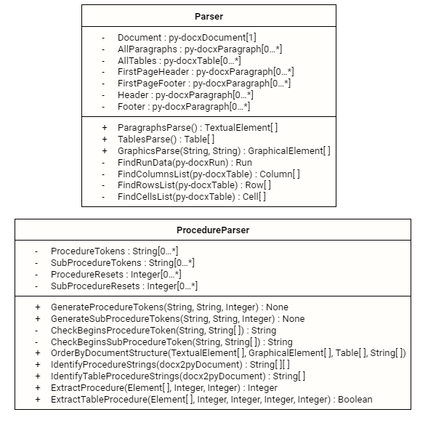
Parser Classes
Mason Lanham

Slide 15
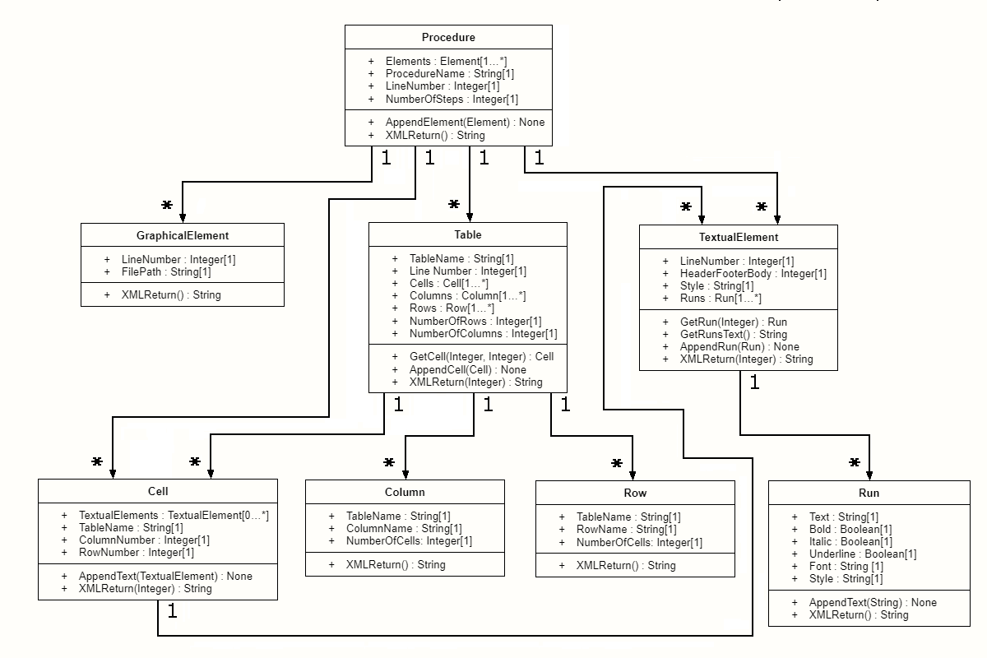
Document Class Hierarchy
Mason Lanham

Slide 16
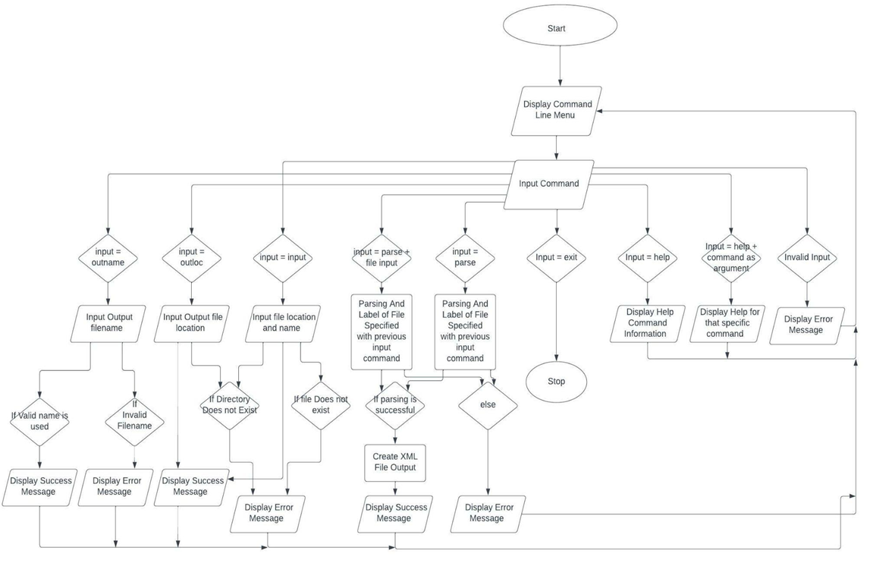
Flow Chart
Mason Lanham

Slide 17
What Happens When Parsing?
Mason Lanham
Generate Tokens
Identify Document Structure
Extract Elements into Array
Order Array by Document Structure
Search for Procedure Strings
Extract Elements into Procedures
Generate the XML code
Save in the output file(s)

Slide 18
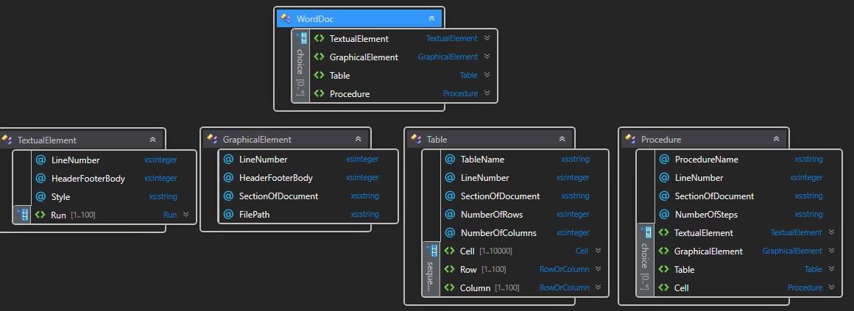
XML Schema
Mason Lanham

Slide 19
Version Control and System Requirements
Mason Lanham
We used Github as our Version Control System.
Requirements to Run Word Data Extractor:
Python 3.3 or newer
Python-docx Module
Docx2txt Module
Docx2python Module

Slide 20
Test Plan Documentation

Slide 21
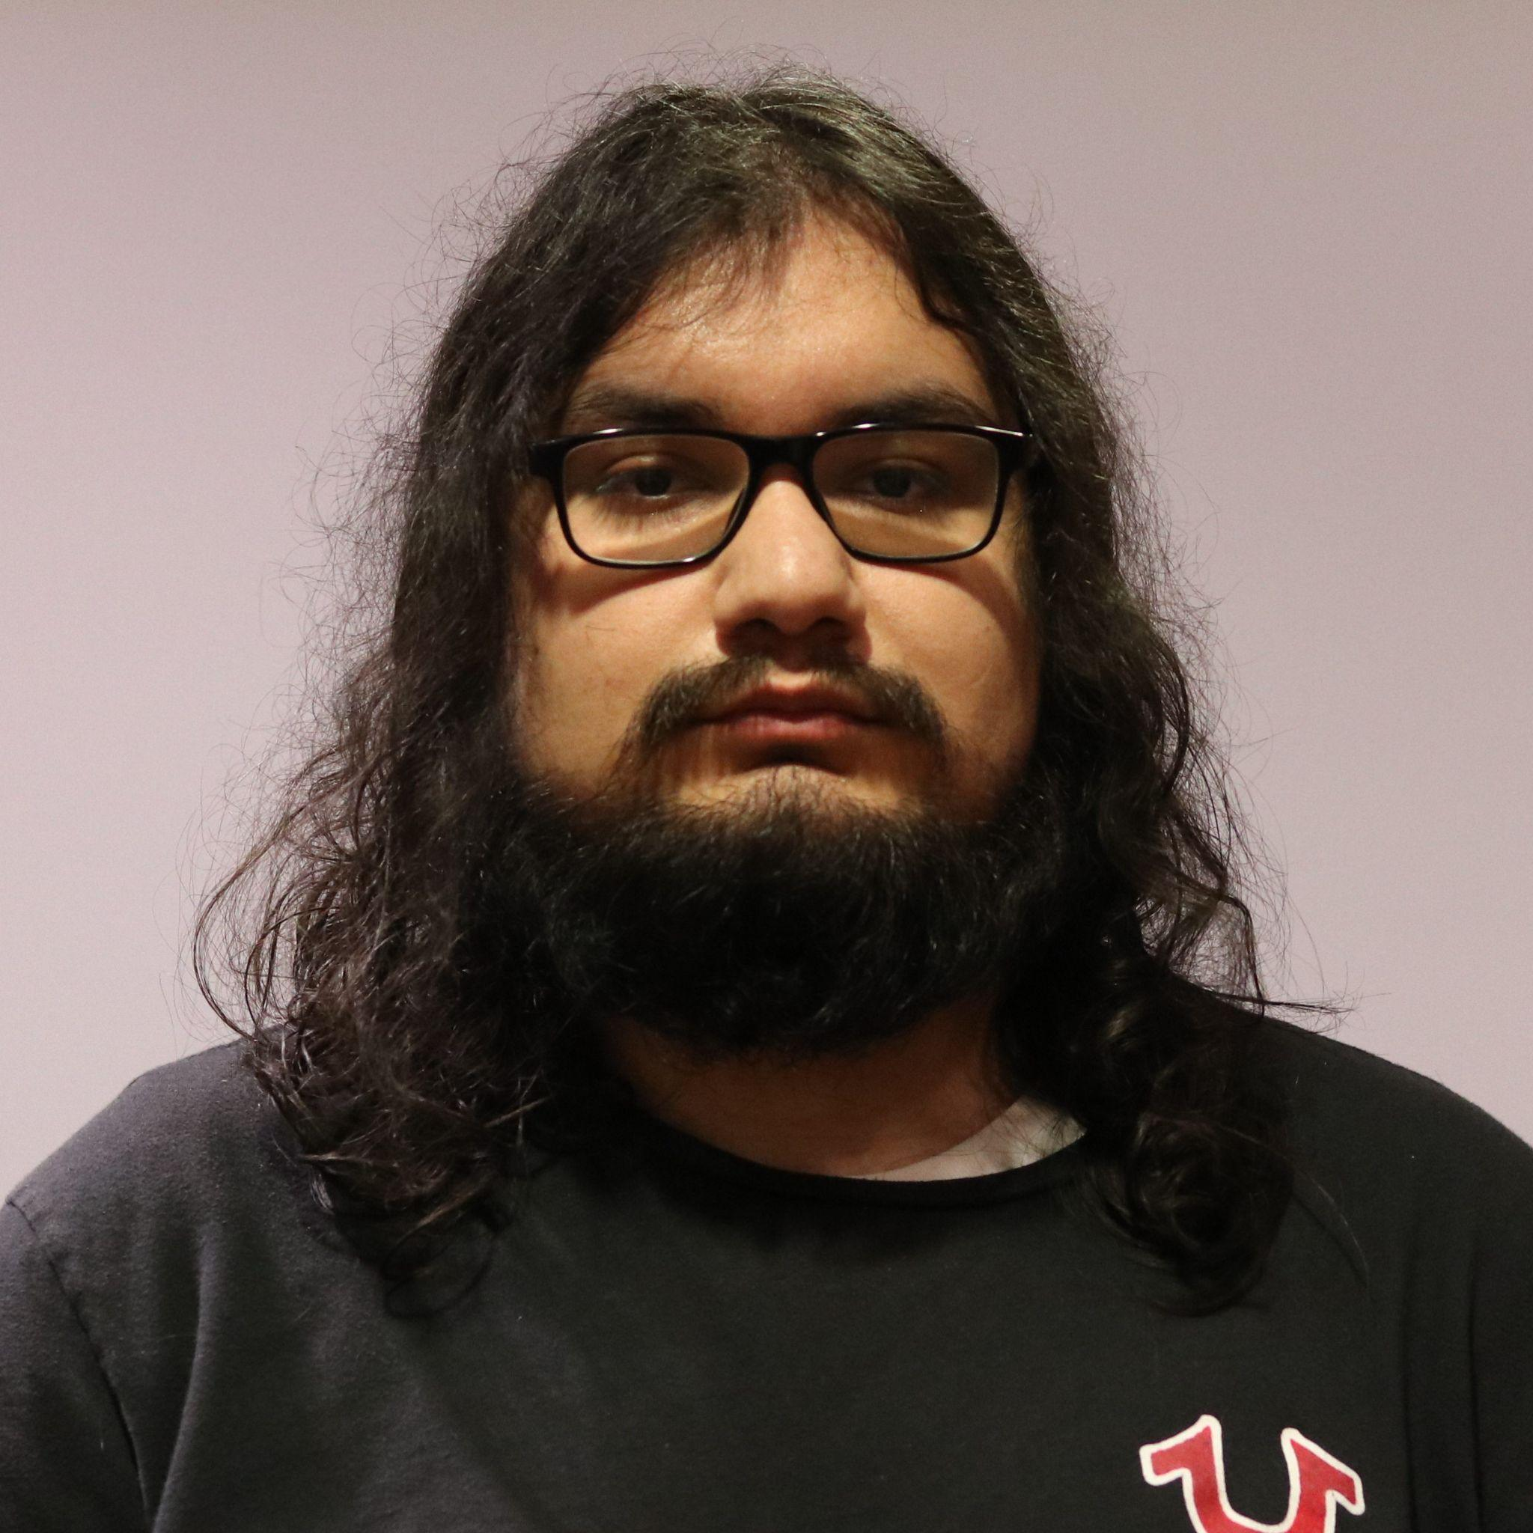
Approach
Chris Mendoza
To test our project we first completed unit testing of each individual class to make sure they were functional and working as intended. Once unit testing was completed we performed system integration and moved on to system testing to make sure the program met the requirements.

Slide 22
Suspension Criteria and Resumption Requirements
Chris Mendoza
Suspension Criteria | Resumption Requirements
Commands are not working as intended. | The command must be fixed immediately due to some commands being dependent on others. Once the team resolves the issue, return to testing.
Significant errors in the XML output of the Word Document | Team will meet to solve the error to resume testing

Slide 23
Test Cases
Chris Mendoza
Our Test plan contained 7 test cases.
TC-1: Parse and Label Docx Document
TC-2: Set Output File Location
TC-3: Set Output File Name
TC-4: Set Input File Location and Name
TC-5: Use Help Options
TC-6: Start the Program
TC-7: End the Program
Each Test Case corresponding to a command that our program requires and one test case for starting the program. Due to the nature of our project, there were no features of the program that were not included in the testing.

Slide 24
Issues/Defects
Chris Mendoza
Upon testing we discovered the following issues:
Program is unable to extract text boxes
Program is unable to extract hyperlinks
When testing was suspended we discovered that the python-docx module cannot be used to extract text boxes and hyperlinks. Due to time constraints we were unable to correct these issues since we would need to need to find and research another module to handle these or develop a way around these issues.

Slide 25
Project Demo

Slide 26


Slide 27
Conclusion & Self-Reflections
System Testing is a long process - Mason Lanham
I earned valuable experience in every aspect of development, as well as handling the personal challenges that came with it - Austin Meredith
I learned how to work effectively as a member of a software development team - Luis Carrillo
I learned how to create the deliverables of the Software Development Lifecycle. - Chris Mendoza
I learned aspects of the Development Lifecycle I was unaware of - David Garcia

Slide 28
Any Questions?
Mason Lanham
Lee Austin Meredith
Luis Carrillo
Chris Mendoza
David Garcia
Notes:
Conclusion REPLACE IMAGES WITH YOUR OWN, just using the order from intro slide since start of project

